Slide 1

Configuration Management for the Web Stack
Jeffrey Palermo
Managing Partner & CEO, Clear Measure
@jeffreypalermo
jeffrey@clear-measure.com

Slide 2
Agenda
What this talk is / what it is not
About myself (who cares, get with the goods!)
What the web stack looks like
Why configuration management matters (worldview)
Source Control & Builds
Continuous Integration
Continuous Testing / Continuous Delivery

Slide 3


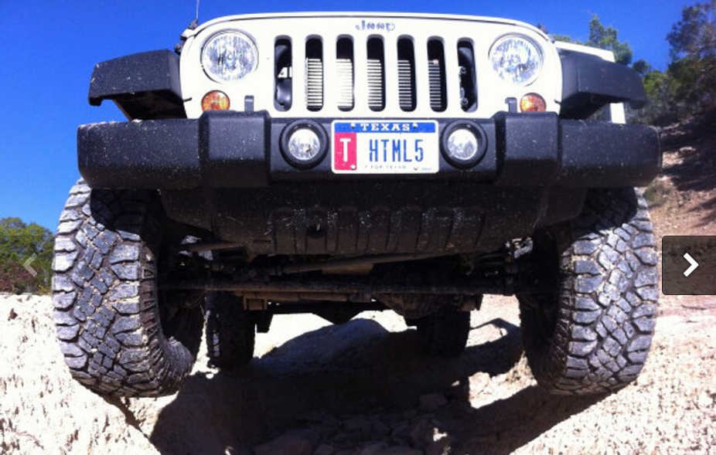
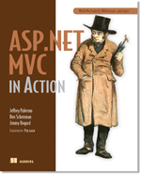

Who is this Jeffrey Palermo guy?
Personal
Father of three
Iraq veteran 2003-2004
Eagle Scout
Christian
Jeep off-roader
Professional
Programming for IIS since 1997
Left Headspring, joined Clear Measure, a full-service custom software company
Written some articles, books, & blogs
Speaker at local conferences, MS Tech Ed, VS Live, DevTeach, etc
Ran Austin .Net User Group from 2005-2011
Microsoft MVP
We are hiring!

Slide 4
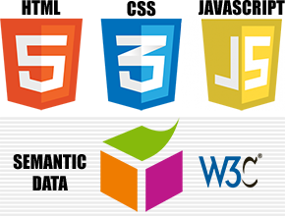

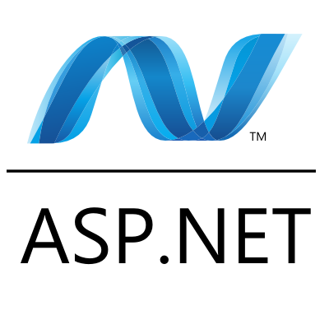
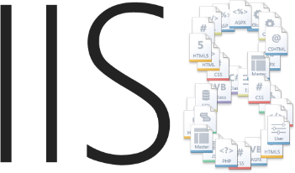
Web Stack

Slide 5
Why Configuration Management Matters

Slide 6
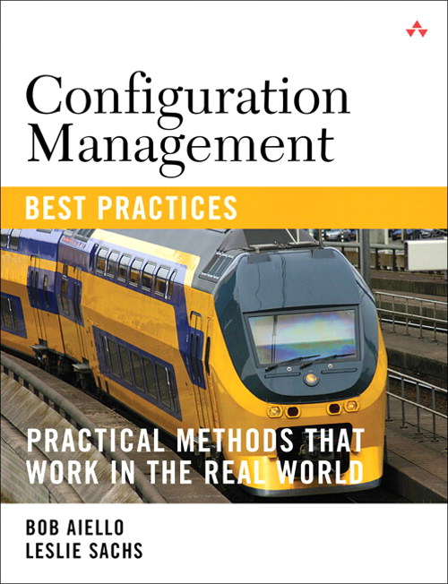
What is SCM?
What is Software Configuration Management
Source code management
Build engineering
Environment configuration
Change control
Release engineering
Deployment

Slide 7
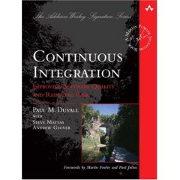
What is continuous integration?
It is the process of integrating small changes into the larger software system “early & often”
Creates frequent feedback in order to reduce the risks involved with changing your software system.
Reduces Risk by turning a large task into small bit sized chunks.

Slide 8
The Problem/Solution
“In my early days in the software industry, one of the most awkward and tense moments of a software project was integration. Modules that worked individually were put together and the whole usually failed in ways that were infuriatingly difficult to find. Yet in the last few years, integration has largely vanished as a source of pain for projects, diminishing to a nonevent.” – Martin Fowler, Foreword to Continuous Integration

Slide 9




Day 1 SCM
Developer
Developer
Source code management
Developer
Build engineering/ Environment configuration
Working
Software
Feedback

Slide 10
What to set up right away
Step 1 VCS
Source control structure
Gather dependencies
Step 2 Build
Compile
Step 3 Test
Deploy
Basic testing
Test
Package

Slide 11
Version Control System (VCS)
Also called Source Code Control (SCC)

Slide 12
Version control shapes your world-view
Locking
Non-Locking
Code is dangerous/risky to change
If someone is looking at a file, we need to keep others out
We need to be careful and intentional to keep the software stable
Code is safe/easy to change
It’s ok if multiple people change the same code file at the same time.
Sophisticated process and tools enable guaranteed recovery from any instability

Slide 13
VCS & VS Solution Setup (DEMO)
Temporarily ignoring application layers

Slide 14
Build the software
Anyone heard of continuous integration?

Slide 15
Build engineering
Private Build – used by each developer to build and test their changes before they commit code to version control.
Integration Build – verifies each developers change against the entire systems. This ensures that the code in source control contains a working system.

Slide 16
Environment configuration
All configuration for the target environment should be done or simulated before each automated build.
Examples:
Database connection strings
Application config settings
Environment variables
Operating System settings
Web server settings

Slide 17
Demo agenda
Private build
Environment configuration(database)
Unit tests
Release packaging
Version, zip
Continuous Integration server setup

Slide 18
Evolution in Software Configuration Management

Slide 19
Testing Requires a Deployment
DEMO web testing with MVC

Slide 20
Ask questions!
@jeffreypalermo
Jeffrey@clear-measure.com
512-298-1232 x377
JeffreyPalermo.com

